Slide 1
Three kinds of dependence
“in”
  A is in B = A ontologically depends on B.
    i.e., A exists only because of B.
  Think of the way a basketball’s qualities inhere in the basketball.
  A substance is “in itself”: it doesn’t depend on anything else for its existence.
“conceived through”
  A is conceived through B = A conceptually depends on B.
    i.e., A can be understood/known only in terms of B.
  The only way to understand/know the bumpiness of a basketball is in terms of the basketball itself.
  A substance is “conceived through itself”: it doesn’t depend on anything else for its conceptualization.
cause-effect
  A is caused by B = A is the effect of B.
  E1a4: “The knowledge [cognitio] of an effect depends on and involves the knowledge of a cause”: causal relations go with conceptual relations.

Slide 2
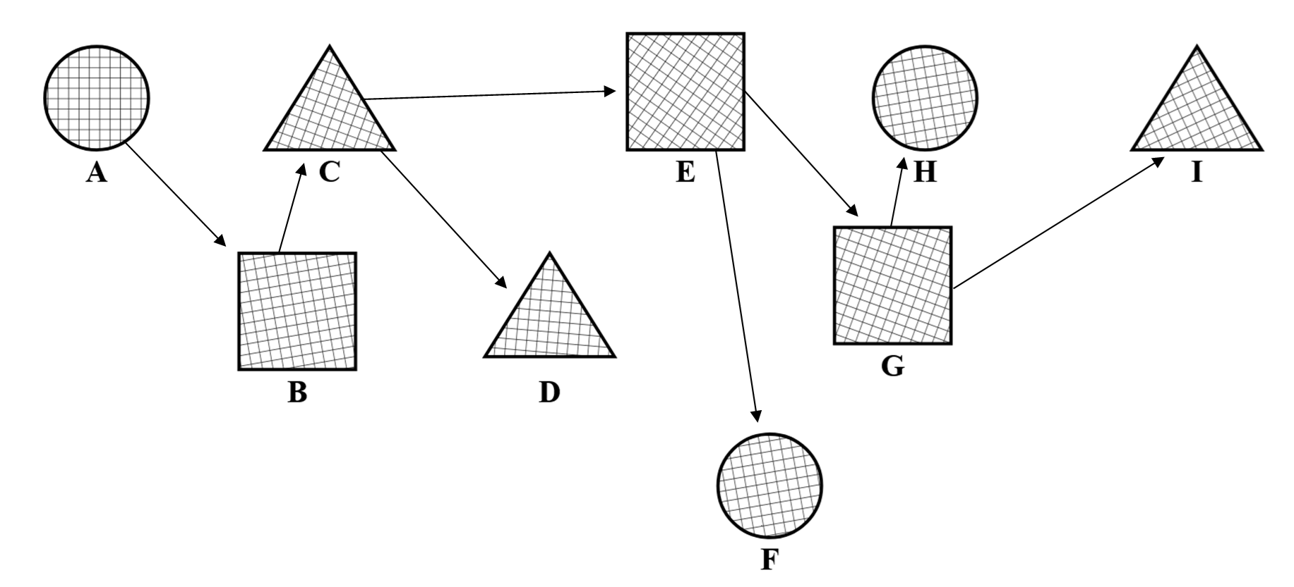

Slide 3
E1p1: substance prior to modes
“Substance is by nature prior to its modifications [affectionibus].”
Spinoza has three words he uses, which may be equivalent:
  ‘modes’ = ‘modifications’ = ‘affections’
  cf. Descartes, Principles of Philosophy: “By mode, as used above, we understand exactly the same as what is elsewhere meant by an attribute or quality. But we employ the term mode when we are thinking of a substance as being affected or modified[.]”
We know modes depend on substances in two ways:
  modes are in substances and conceived through substances
  this is just the definition of ‘substance’ (E1d3) and the definition of ‘mode’ (E1d5)
What Spinoza might be getting at already:
  each substance is what it is, prior to and independent of its modes

Slide 4
E1p2: substances differing by attribute have nothing in common
“Two substances whose attributes are different have nothing in common.”
Think of what Descartes would say about a mind and a body:
  Minds and bodies have completely different attributes: THOUGHT and EXTENSION.
  Minds and bodies have completely different modes: all a mind’s modes are thoughts, ideas, etc., all a body’s modes are shapes, motions, etc.
Different substances of different types, of different natures, with different attributes, are utterly different from each other:
  alternatively: for two substances to have anything in common with each other, they need to at least have the same attribute (e.g., in the Cartesian system, only a same-attribute pair like two bodies or two minds could have something in common)

Slide 6
E1p3: cause and effect must have something in common
“Things that have nothing in common
cannot be the cause of one another.”
Remember, causal relations go with conceptual relations (E1a4):
  if A is caused by B, then A is conceived through B
  an effect can be understood only in terms of its cause
  “The knowledge [cognitio] of an effect depends on and involves the knowledge of a cause.”
And conceptual relations go with having something in common (E1a5):
  how could A be conceived through B if A had nothing in common with B? (perhaps, e.g., a ball’s shape and the ball itself)
  “Things that have nothing in common cannot be understood [intelligi] by means of one another; in other words, the concept of one does not involve the concept of the other.”

Slide 8
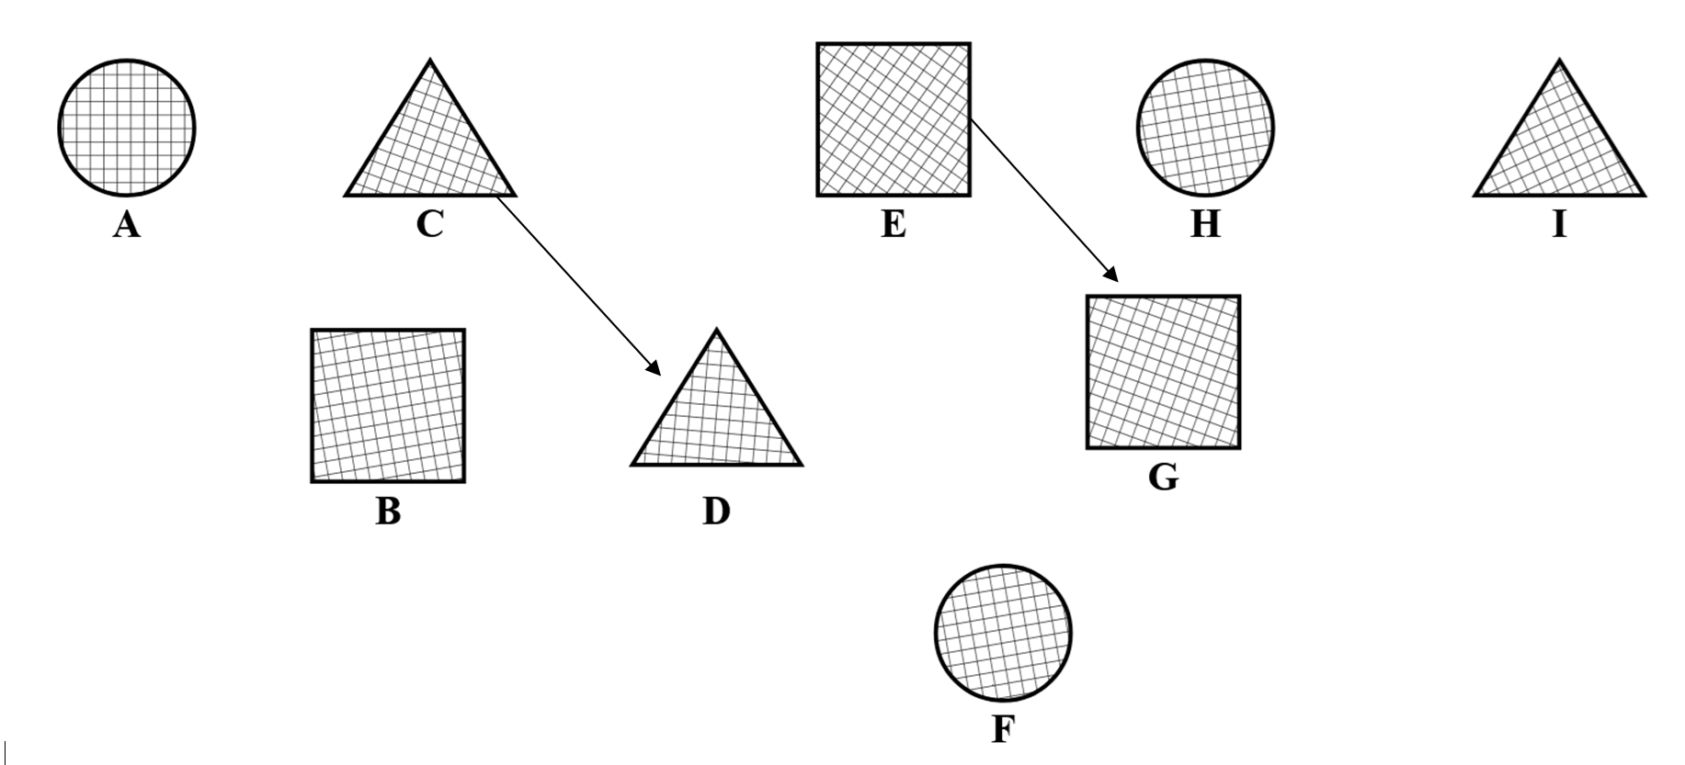

Slide 9
E1p4: distinctness is due to differing attributes or differing modes
“Two or more distinct things are distinguished from one another either by the difference of the attributes of the substances
or by the difference of their modifications.”
Spinoza assumes that if A ≠ B, then A and B must differ somehow:
  for any distinct pair, the distinctness needs an explanation in terms of the two differing somehow, being discernible
  no identical twins / identity of indiscernibles
Nothing in the world other than substances and modes (E1a1)
Only two possible ways for A and B to differ:
  A and B differ in their attributes: e.g., A is a mind, B is a body
    assuming some sort of equivalence between a substance and its attribute: E1d4: “By attribute I mean that which the intellect perceives about a substance as constituting its essence”
  A and B differ only in their modes (they’re alike in attribute): e.g., A and B are both minds and they have different thoughts

Slide 11
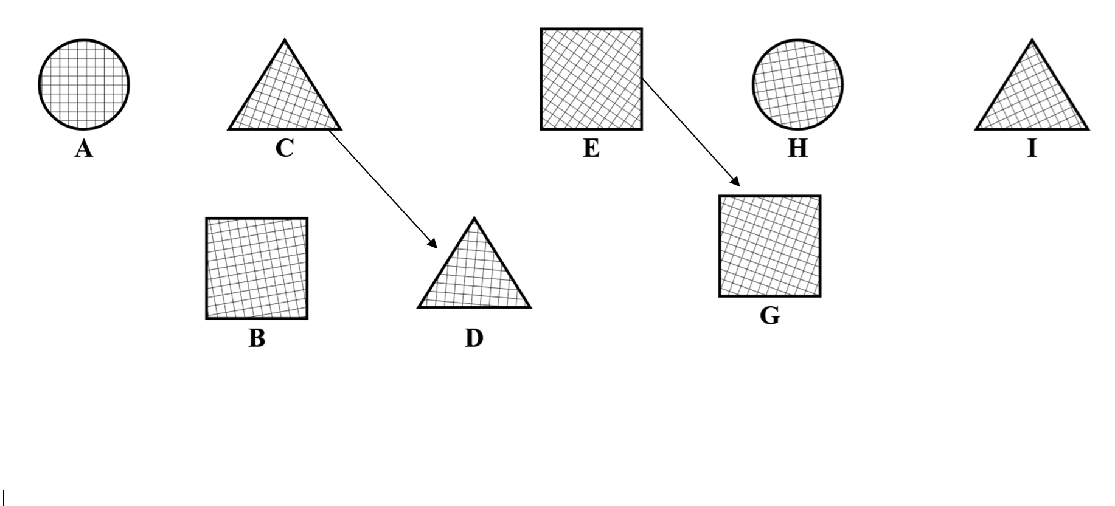

Slide 12
E1p5: only one substance per attribute
“There cannot exist in the universe two or more substances having the same nature or attribute.”
No two substances with the same attribute:
  can’t have two distinct minds, or two distinct bodies
  can’t have two substances that differ only in their modes but have the same attribute
Can’t have two substances distinct due to differing in modes, because you can’t have modes be prior to substance:
  supposing that A and B differ only in modes, then what makes A the substance it is (as distinct from B) is its modes
  then the substance A would be what it is because of its modes!
  “if by the difference of their modifications—as substance is naturally prior to its modifications (1p1)—it follows that if we set the modifications aside and consider substance in itself, that is, truly (1d3 and 1d6), it cannot be conceived as different from another”

Slide 14
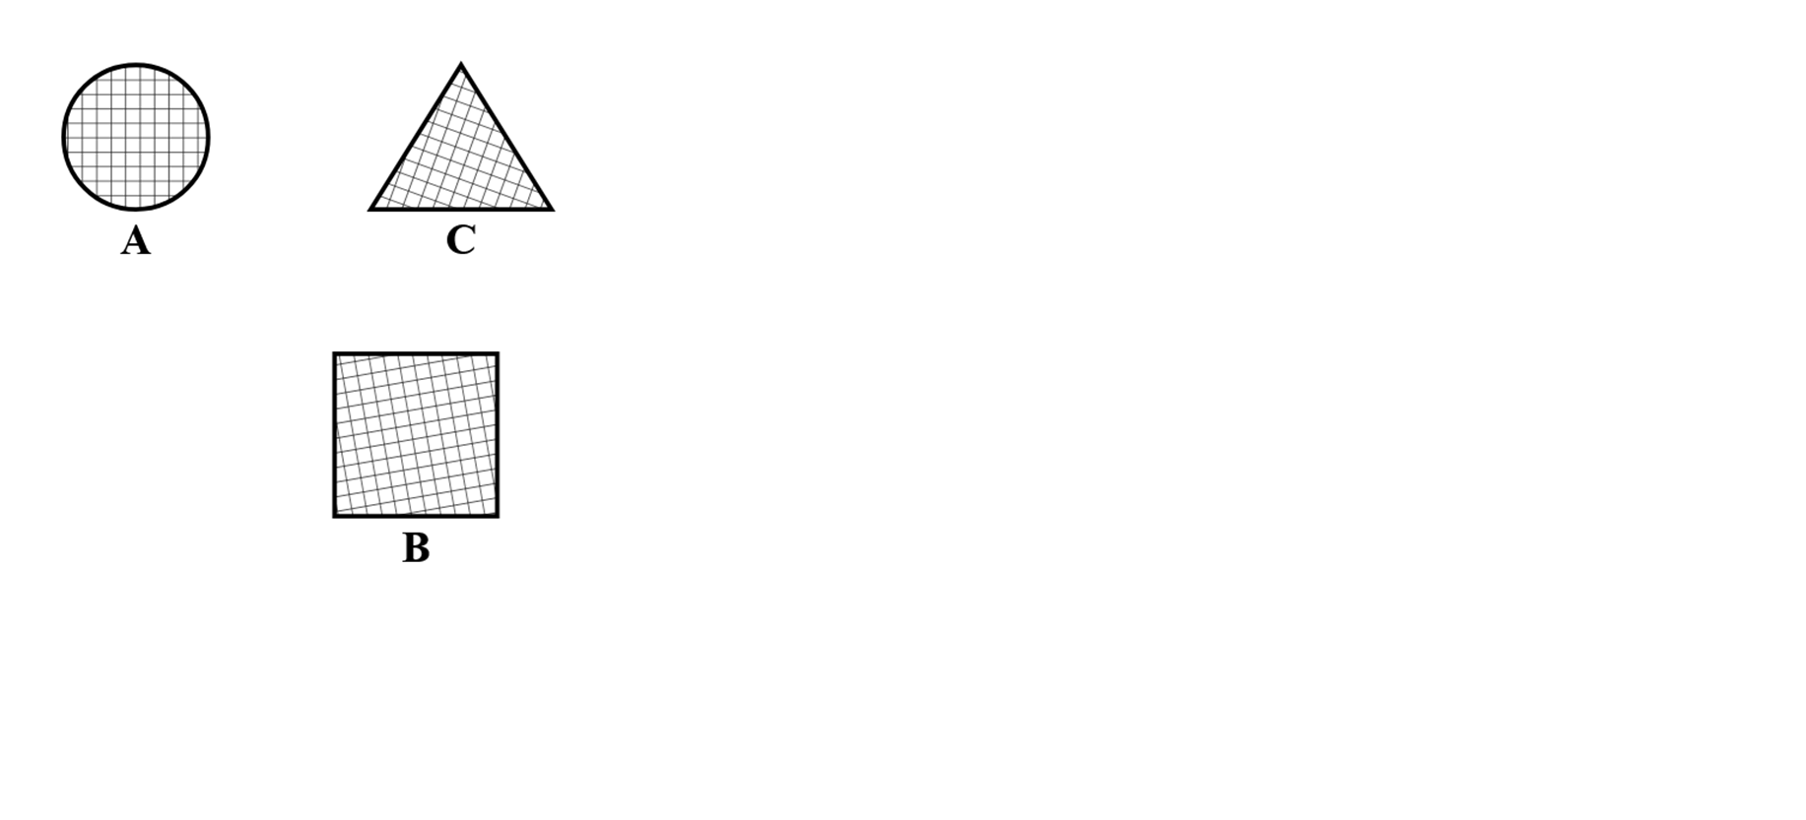

Slide 15
E1p6: impossible for one substance to produce [cause] another
“One substance cannot be produced by another substance.”
For A to produce B, the two must have something in common:
  “Things that have nothing in common cannot be the cause of one another” (E1p3) [production = causation?]
To have something in common, they must be alike in attribute:
  “Two substances whose attributes are different have nothing in common.” (E1p2)
But it’s impossible to have two distinct substances alike in attribute (differing only in their modes):
  “There cannot exist in the universe two or more substances having the same nature or attribute.” (E1p5)
So it’s impossible to have two distinct substances where one produces the other: no substance can be the causal product of some other substance

Slide 16
E1p6c: impossible for a substance to be produced by any external cause
“a substance cannot be produced
by anything other than itself”
There’s nothing to produce a substance besides itself:
  another substance? no, we just disproved that
  a mode? no, a mode depends on a substance, not vice versa
  itself? yes, this is the only possible option
  Spinoza may already be assuming that for any substance there must be something which produces it.
Also, causal dependence goes with conceptual dependence:
  if A is produced by B, then A is conceived through B
    “The knowledge of an effect depends on and involves the knowledge of a cause” (E1a4)
  but a substance is (by definition) conceived only through itself

Slide 17
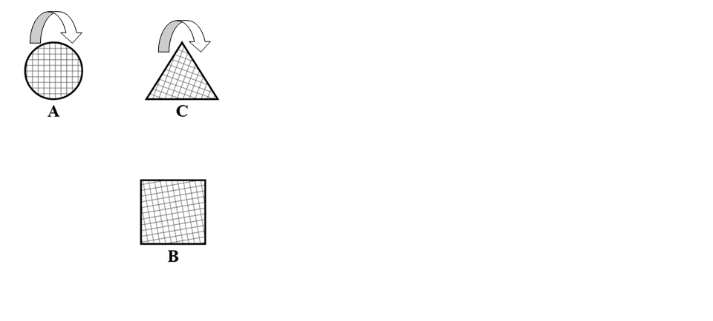
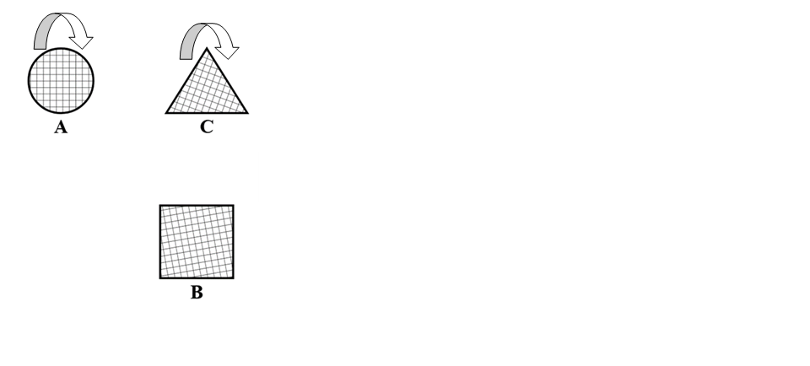
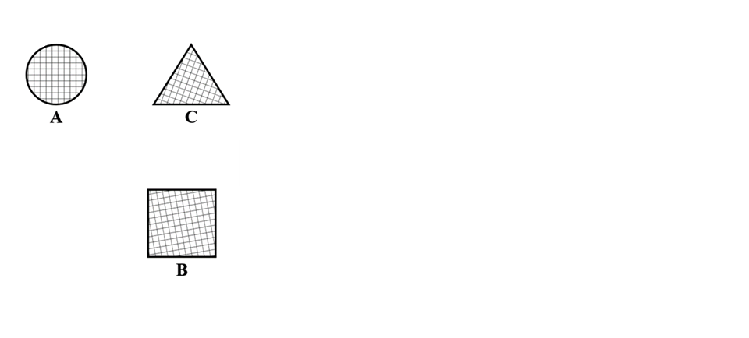

Slide 18
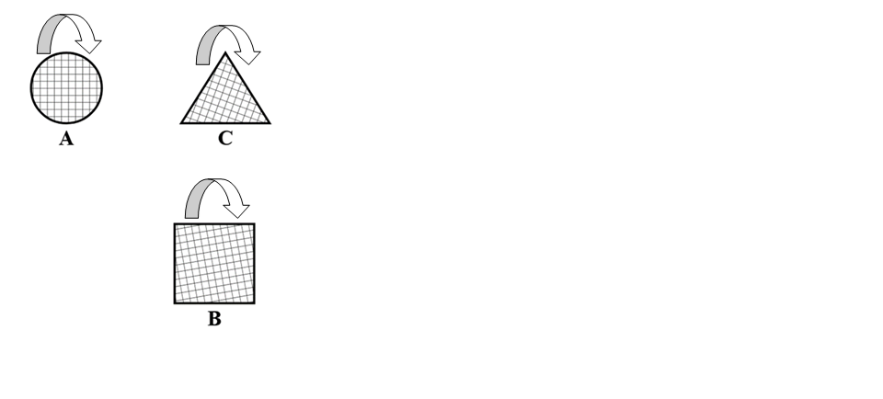
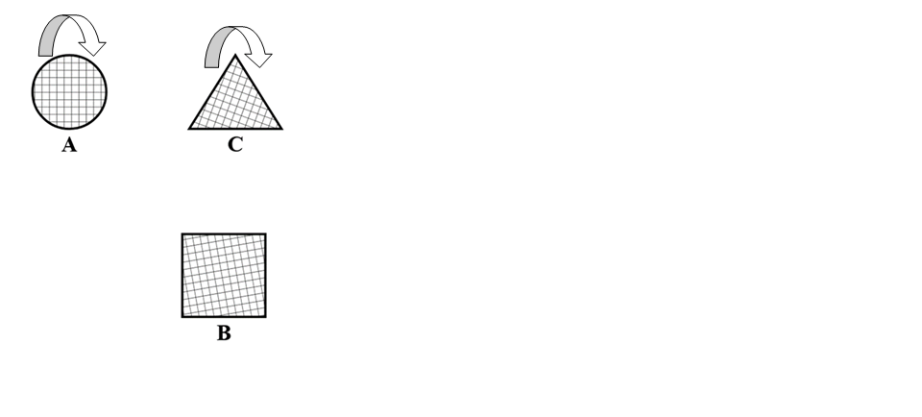
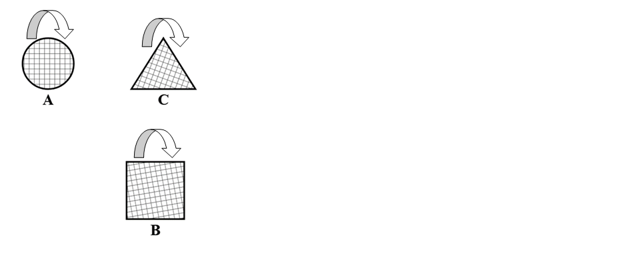

Slide 19
E1p7: substance has existence belonging to its nature
“Existence belongs to the nature of a substance”
Substance must be self-caused (a causa sui):
  it can’t be produced by anything else, so it can only be a causa sui
  “By self-caused I mean that whose essence involves existence, that is, that whose nature is only conceivable as existent”
  no external cause, only an internal cause (in its own essence)
Just like Descartes’s God: it belongs to its very essence that it must exist (Fifth Meditation):
  “one cannot separate existence from the essence of God, any more than one can separate the fact that the sum of the three angles in a triangle is equal to two right angles from the essence of a triangle, or separate the idea of a valley from the idea of a mountain”

Slide 21
E1p8: substance must be infinite
“Every substance is necessarily infinite.”
Substance must be infinite:
  maybe not absolutely infinite, but at least infinite after its own kind
  e.g., extended substance must be infinite extended substance
Finite substance would involve a fellow limiting substance:
  finite because limited by a second substance of the same kind
  e.g., a finite body would have to be limited by some other body
  but you can’t have two substances of the same kind (E1p5)
  e.g., an extended substance is the one and only extended substance—infinite after its own kind
Any causa sui must be infinite (E1p8s1):
  its existence stems from its nature, not from anything external
  the existence of its nature is not at all denied, hence it’s infinite

Slide 22
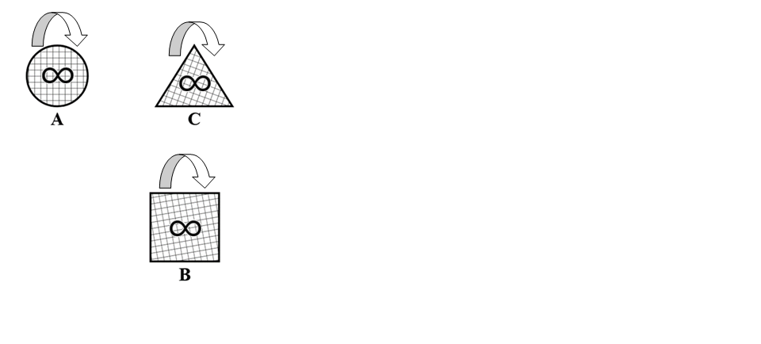

Slide 23
1p9: More reality means more attributes
Attributes constitute the essence of a substance.
So the more reality/being/perfection there is to the essence of something, the more attributes it has.
1p10: Each attribute is conceived through itself
Just like substances! Conceptual isolation.
So we can’t use one attribute to rule out another attribute—that crosses the conceptual barrier.
“A has the attribute THOUGHT, so A cannot have the attribute EXTENSION”? This inference is no good.
A substance can have many different attributes.

Slide 24
1p11: An absolutely infinite substance (God) exists
Not just infinite in its kind, but absolutely infinite:
  This substance possesses infinitely many attributes, each attribute expressing eternal and infinite essence.
Ontological argument: such a substance must exist, because its essence involves existence.
Argument #2: God’s nonexistence couldn’t be due to something external (no substances are causally related) or internal (God’s nature has no contradiction).
Argument #3: If only finite beings exist, then they are more powerful than an infinite being, which is absurd.

Slide 25
1p12: A substance is indivisible
If its parts retain the nature of substance, then:
  from a single substance many substances can be formed, which would cross the causal barrier (1p6).
  each new substance would have a different attribute and would have nothing in common with its cause, which would screw up the part-whole relationship.
If its parts lose the nature of substance, then the substance would be destroyed, which is impossible.
So it’s impossible to divide a substance into parts.
  Even a substance conceived under the attribute EXTENSION is indivisible.

Slide 26
1p13: An absolutely infinite substance is indivisible
If its parts retain the nature of God, then there would be many Gods (many substances of the same absolutely infinite nature), which is impossible.
If its parts lose the nature of God, then God would be destroyed, which is impossible.
So it’s impossible to divide God into parts.

Slide 27
1p14: God is the only possible/conceivable substance
God has every attribute, so if there were a second substance, it would have to have one of the same attributes already had by God.
But it’s impossible for two substances to have the same attribute (1p5).
So no other substance can be (or be conceived as existing).
  God is the one and only substance, absolutely infinite.
  Any mind or body is either an attribute or a mode of God’s attribute.
Substance Monism!

Slide 28
1p15: Everything else is a mode of God
Substances and modes are all there is.
But there’s only one substance: God.
So everything else is a mode of God: in God and conceived through God.
  In particular, so-called ‘extended substance’ is just one of God’s infinite attributes.
  This is no problem, because it’s already been shown that no substance can be divided, so it’s not like this threatens God with divisibility.

Slide 29
1p16: Infinity follows from God
Essence and properties:
  The more reality in x’s essence, the more properties inferred from x’s definition by the intellect
  God is absolutely infinite substance: the divine nature has infinitely many infinite-essence attributes
  So infinity follows from God: “an infinite number of things in infinite modes” or “an infinity in infinite ways” (what could be inferred by “infinite intellect”)
It all follows necessarily:
  God is cause of these infinite effects, in that they follow “[f]rom the necessity of the divine nature”
  Much like properties follow from the essence of a triangle

Slide 30
1p17: God acts uncompelled, by the laws of the divine nature
Nothing to compel God:
  All things are in God, so there is nothing external to determine or compel God to act
From the divine nature:
  These effects of God’s activity follow from the divine nature: i.e., from its necessity, from its laws
  It’s not as if God has some choice in the matter as to what does or does not follow: God’s omnipotence consists in infinite power producing infinite effects
  If intellect or will did pertain to God’s nature (they don’t), they would be radically different from anything else we call ‘intellect’ or ‘will’

Slide 31
Additional points in Part I
What happens follows from God’s nature, not from some divine free will:
  Anything God can do, he does do. There is no divine will separate from a divine intellect.
  God is ‘free’ only in the sense of there being nothing external compelling God.
Nature = God:
  More precisely, Natura naturans is the substance and its attributes, whereas Natura naturata is the modes of the substance.
What happens is absolutely necessary:
  It necessarily follows from something that couldn’t have been otherwise.
  Contingency is merely a matter of ignorance.

Slide 32
Additional points in Part I’s Appendix
The number one prejudice to be overturned: “all natural things act for an end”:
  We humans act under the illusion of freedom, and we’re self-interested.
  We attribute conveniences in nature to superhuman gods with fickle temperaments that need to be (superstitiously) appeased.
  We attribute inconveniences in nature to the gods’ anger with us for our sins.
  But these inconveniences show up so indiscriminately that we’re forced to posit “mysterious ways”.
  We would have been stuck in ignorance forever, were it not for mathematics: essences/properties instead of ends.

Slide 33
Additional points in Part I’s Appendix
Showing that final causes are human fictions:
  See E1p16 (p. 376); E1p32c1, E1p32c2 (p. 382)
  They turn nature upside down, getting cause and effect backwards.
  They detract from God’s perfection: he doesn’t lack anything and has no need of or desire for anything.
  They encourage arguments from ignorance: “how, if not through God’s will, could a stone have fallen exactly at that time on that person’s head???”
  They encourage foolish wonder, instead of seeking to understand natural things mechanically (e.g., human anatomy, miracles).

Slide 34
Additional points in Part I’s Appendix
Other notions (used for explaining nature) are “beings of imagination”:
  We judge by what benefits us: good, evil, order, confusion, beauty, ugliness, etc.
  Or by what encourages worship of God.
  Or by what’s easy to imagine: well-ordered, confused, etc.
  “Men have been so mad as to believe that God is pleased by harmony.”
  And all this gives rise to controversies, and then skepticism, and the problem of evil.
  Instead of recognizing that God produces everything he can, necessarily and by the laws of his nature.

Slide 35
Part II: The Human Mind
Among God’s infinite attributes are the attribute THOUGHT and the attribute EXTENSION:
  Everything that follows from God’s essence also shows up in God as an idea: all this under the attribute THOUGHT.
  The modes of an attribute are caused by God under that attribute, not under any other attribute.
“The order and connection of ideas is the same as the order and connection of things”:
  ‘Parallelism’: the system of cause and effect under one attribute can also be understood under the attribute THOUGHT as a system of ideas.
  ‘Dual-aspect theory’: each mental state can also be understood as a physical state, and vice versa.

Slide 36
Part II: The Human Mind
“For example, a circle existing in Nature and the idea of the existing circle, which is also in God, are one and the same thing, which is explained through different attributes. Therefore, whether we conceive Nature under the attribute of Extension, or under the attribute of Thought, or under any other attribute, we shall find one and the same order, or one and the same connection of causes, i.e., that the same things follow one another.” (1p7s)
A human mind is just an idea of a certain mode of extension: viz. the human body.
  This is “what should be understood by the union of Mind and Body”.
  “[T]o determine what is the difference between the human Mind and the others, and how it surpasses them, it is necessary for us, as we have said, to know the nature of its object, i.e., of the human Body.”

Slide 37
Part III: The Affects
There is no mind-body interaction:
  “The Body cannot determine the Mind to thinking, and the Mind cannot determine the Body to motion, to rest or to anything else (if there is anything else).”
    What determines the mind? Mental causes.
    What determines the body? Physical causes.
    “[T]he Mind and the Body are one and the same thing, which is conceived now under the attribute of Thought, now under the attribute of Extension.”
  The notion that the mind has free dominion over the body is an illusion.
    “All these things, indeed, show clearly that both the decision of the Mind and the appetite and the determination of the Body by nature exist together—or rather are one and the same thing, which we call a decision when it is considered under, and explained through, the attribute of Thought, and which we call a determination when it is considered under the attribute of Extension and deduced from the laws of motion and rest.”

Slide 39
Three kinds of dependence
“in”
  A is in B = A ontologically depends on B.
    i.e., A exists only because of B.
  Think of the way a basketball’s qualities inhere in the basketball.
  A substance is “in itself”: it doesn’t depend on anything else for its existence.
“conceived through”
  A is conceived through B = A conceptually depends on B.
    i.e., A can be understood/known only in terms of B.
  The only way to understand/know the bumpiness of a basketball is in terms of the basketball itself.
  A substance is “conceived through itself”: it doesn’t depend on anything else for its conceptualization.
cause-effect
  A is caused by B = A is the effect of B.
  A4: “The knowledge of an effect depends on, and involves, the knowledge of its cause”: causal relations go with conceptual relations.

Slide 40
1p1: Substance prior to modes
Modes depend on substances:
  Modes are in and conceived through substances.
  This is just the definition of ‘substance’ (D3) and the definition of ‘mode’ (D5)
Sometimes Spinoza uses the word ‘affections’ instead of the word ‘modes’.
  Also ‘modifications’

Slide 41
1p2: Different-attribute substances have nothing in common
Think of what Descartes would say about a mind and a body.
  All a mind’s modes are thoughts. All a body’s modes are shapes, motions, etc.
Each type of substance must exist and be understood on its own terms.

Slide 42
1p3: Cause and effect must have something in common
Remember, causal relations go with conceptual relations. (A4)
  If A is caused by B, then A is conceived through B.
  An effect can be understood only in terms of its cause.
And conceptual relations go with having something in common. (A5)
  How could A be conceived through B if A had nothing in common with B?

Slide 43
1p4: Distinctness is due to differing attributes or differing modes
Nothing in the world other than substances and modes.
And if A ≠ B, then A and B must differ somehow.
Only two possible ways for A and B to differ:
  A and B differ in their attributes: e.g., A is a mind and B is a body.
  A and B differ in their modes (but are alike in attribute): e.g., A and B are both minds and they have different thoughts.

Slide 44
1p5: Impossible to have two substances alike in attribute differing only in modes
Impossible to have two distinct minds, or two distinct bodies.
If A and B differ only in modes, then when you set aside their modes and focus on A itself and B itself, there is no difference between A and B.
And that means A and B are identical after all.
For example, if two minds differ only in their modes, then there is no difference between one mind and the other when you focus on the minds themselves—which means it’s just one mind after all!

Slide 45
1p6: Impossible for two substances to be causally related
For two substances to be causally related, they must have something in common.
But to have something in common, they must have the same attribute.
But it’s impossible to have two distinct substances alike in attribute (differing only in their modes).
So it’s impossible for one substance to be the cause of another substance.
No substance can causally depend on any other substance! [nor ontologically, nor conceptually]

Slide 46
1p7: A substance must exist by its very essence
Just like Descartes’ God: it belongs to its very essence that it must exist. (Fifth Meditation)
After all, it’s impossible for a substance to causally depend on any other substance.
So it must be self-caused.
In other words (D1), its essence involves existence.

Slide 47
1p8: A substance must be infinite in its own kind
To be finite, a substance would have to be limited by another substance of its own kind.
  e.g., a finite body is limited by some other body
But it’s impossible for there to be more than one substance of a given kind.
So a substance of an attribute is the one and only substance of that attribute.
  e.g., a corporeal substance is the one and only corporeal substance—infinite in its own kind
  After all, it is of the very essence of a substance to exist, and no essence tells us how many exist.

Slide 48
1p9: More reality means more attributes
Attributes constitute the essence of a substance.
So the more reality/being/perfection there is to the essence of something, the more attributes it has.
1p10: Each attribute is conceived through itself
Just like substances! Conceptual isolation.
So we can’t use one attribute to rule out another attribute—that crosses the conceptual barrier.
“A has the attribute THOUGHT, so A cannot have the attribute EXTENSION”? This thinking is no good.
A substance can have many different attributes.

Slide 49
1p11: An absolutely infinite substance (God) exists
Not just infinite in its kind, but absolutely infinite:
  This substance possesses infinitely many attributes, each attribute expressing eternal and infinite essence.
Ontological argument: such a substance must exist, because its essence involves existence.
Argument #2: God’s nonexistence couldn’t be due to something external (no substances are causally related) or internal (God’s nature has no contradiction).
Argument #3: If only finite beings exist, then they are more powerful than an infinite being, which is absurd.

Slide 50
